Slide 1
Predict crime using spatial and temporal approach
A comparison study between Chicago and Seattle
Yangyang Dai
Notes:
the type of crime, the occurrence time and the crime location

Slide 2
Research background and ideas
A crime will happen!!!
When ??
Where ??
Notes:
Supercomputer vision – who will commit a crime and who will be the victim
People tend to commit crimes at where they are familiar with
If we know when and where the next crime will happen, we will be able to prevent it
Crime prevention
Police force allocation

Slide 3
Available studies and resources
Example studies:
Predict London crime rates, predict crime types in Denver, Los Angeles and etc.
Eg. A. Bogomolov, B. Lepri, J. Staiano, N. Oliver, F. Pianesi and A. Pentland, 'Once Upon a Crime: Towards Crime Prediction from Demographics and Mobile Data', CoRR, vol. 14092983, 2014.
Methods overview:
SVM: using this method is still slow and computationally expensive
Fuzzy time series: works well on binary data, but not so much on more levels
Artificial neural network (ANN): relatively accurate, but takes a long time in training phases
Unsupervised method by using multivariate time series based on parametric Minkowski model and dynamic time wrapping (DTW), however, this method is difficult to handle a missing value in order to get more accurate results
Bayesian Network: it may lead to some deviation during conducted the experiment, so the more factors unrelated to the geography should be considered to improve the accuracy of the model.
decision tree: eg, the result of crime cases has been classified into two classes such as neutral and danger. However, this method does not work well on all type of datasets.
logistic regression: the limitation of this approach is difficult to identify the probability of burglary activity and specific locations.

Slide 4
Available studies and resources
Contribution and focuses:
mid-west vs. west coast
the newly developed vs. Early developed
Crime city vs. civilized city

Slide 5
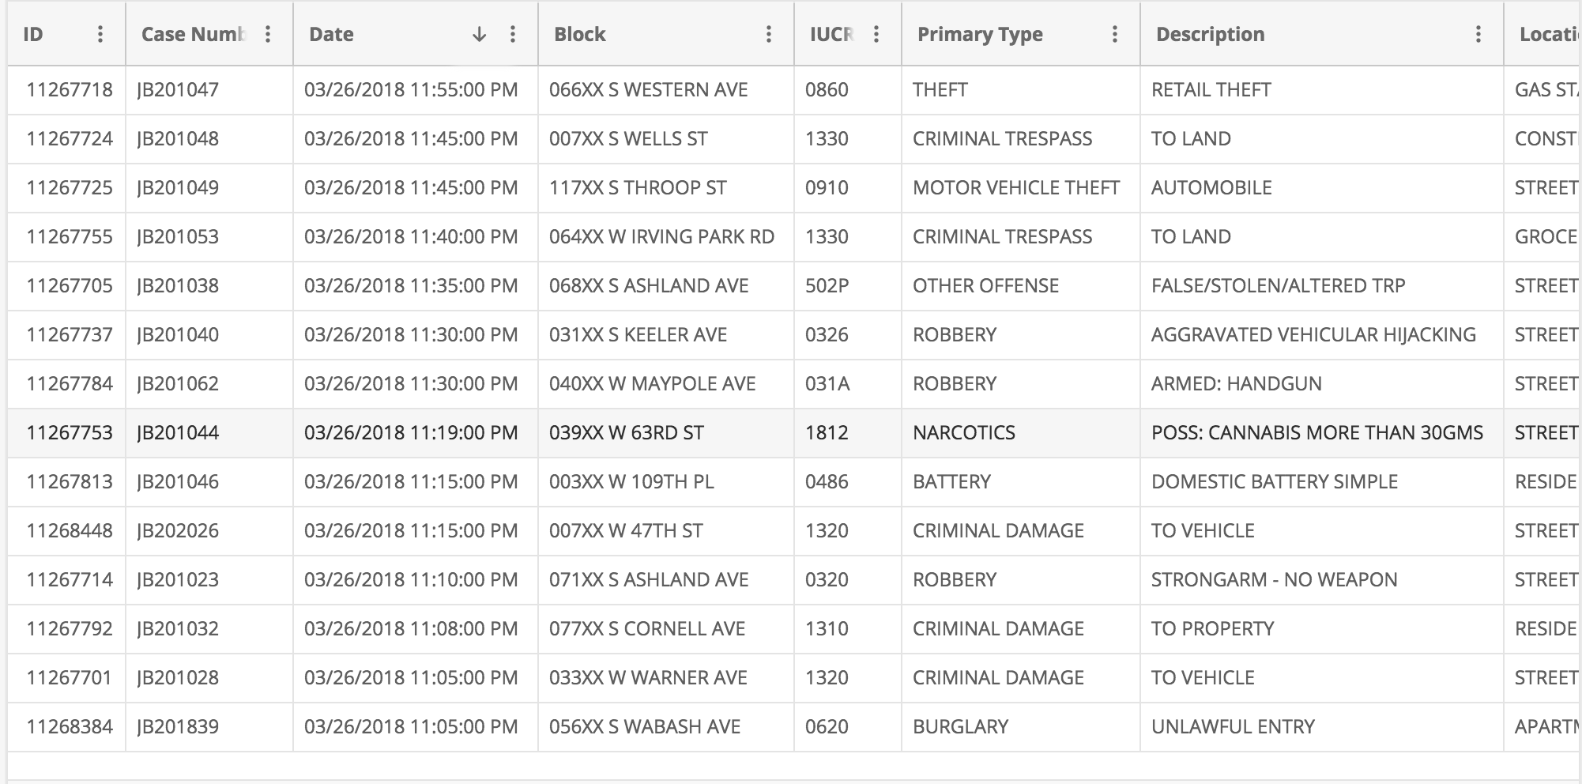
Crime Data
Mid-West
With relatively long history, early-developed
infamous for the crime, gangs
Chicago crime – 2001 to present
extracted from the Chicago Police Department's CLEAR (Citizen Law Enforcement Analysis and Reporting) system
22 attributes (id, date, block, x, y coordinate etc.), 6.57M instances of crimes
https://data.cityofchicago.org/Public-Safety/Crimes-2001-to-present/ijzp-q8t2

Slide 6
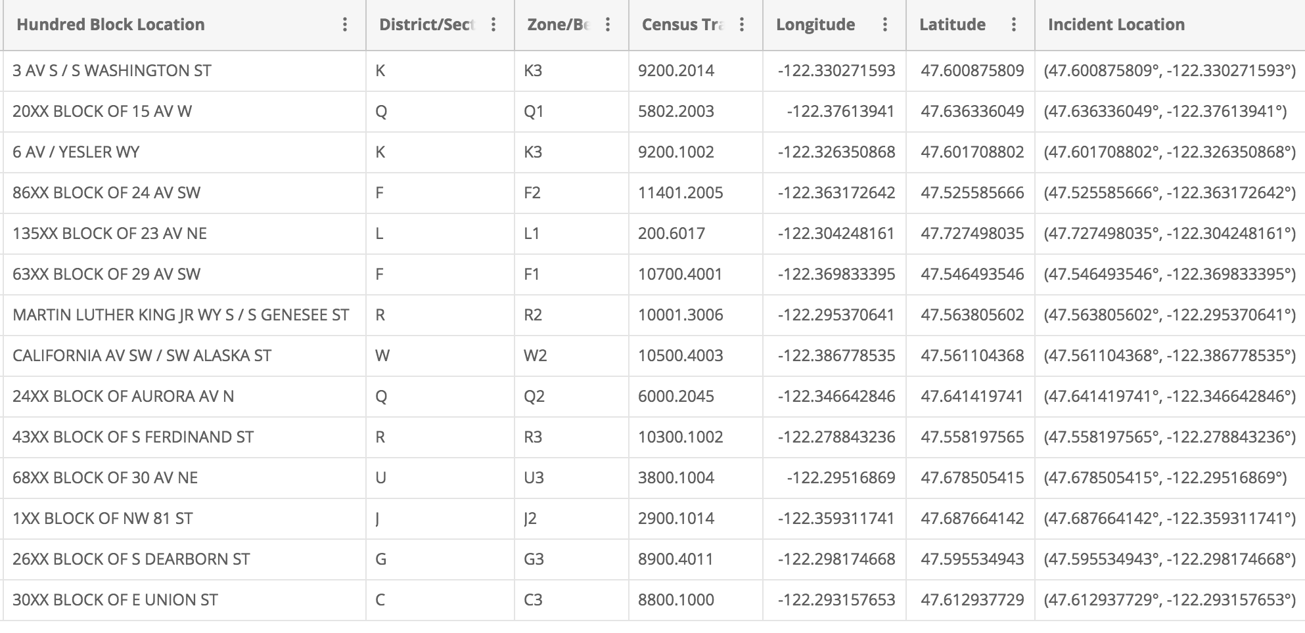
Crime Data
West coast
Newly developed, tech-oriented
Seattle crime – 2010 to 2017
all the Police responses to 9-1-1 calls within the city
19 attributes, 1.47M instances
https://data.seattle.gov/Public-Safety/Seattle-Police-Department-911-Incident-Response/3k2p-39jp?category=Public-Safety&view_name=Seattle-Police-Department-911-Incident-Response

Slide 7
Methods – framework
Ideas:
Build models using Chicago and Seattle crime data, train and test the two models, and predict the crime in each two cities
Compare the temporal and spatial crime distributions
Understand the differences and similarities between two cities
Crime distribution over the 12 months, Weekly distribution, daily distribution
Location or neighborhood differences (apart, street, sidewalk, school…)
Crime type differences

Slide 8
Methods – data preparation
Data cleaning: missing values
Data reduction: eg. possible dimension reduction
Data integration: eg. unify attribute naming, adopt military time system
Data Transformation and Discretization:
create crime_type, crime_time variables, group into smaller subsets if too many, into hour intervals

Slide 9
Methods – models and analysis
Apriori Algorithm
to find all possible crime frequent patterns regardless of the committed crime type
come up with a list of all crime hotspots along with its related frequent time
Naïve Bayesian Classifier
assumes the independent effect between attribute value
sklearn
Multinomial Naïve Bayes, crime type prediction
Decision Tree Classifier
sklearn
entropy function for the information gain to measure the quality of the split
Evaluation:
prediction accuracy
Running time

Slide 10
Potential results
Spatial and temporal hot spots in Chicago and Seattle
Comparison of crime patterns
Predicted Crime type in a given location within a give period of time
Questions?

